Slide 1
Frame Relay

Slide 2
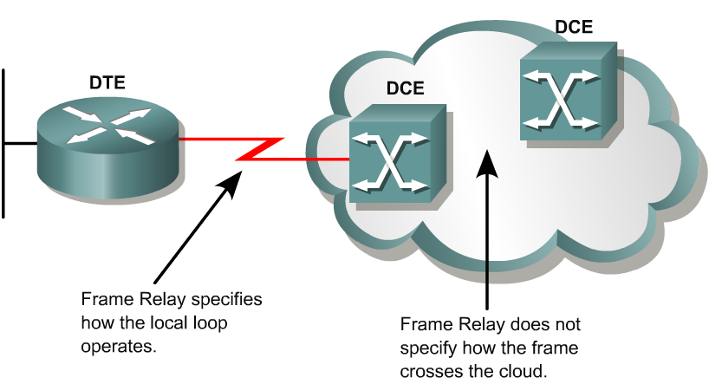
Introducing Frame Relay
Frame Relay is a packet-switched, connection-oriented, WAN service. It operates at the data link layer of the OSI reference model.
Frame Relay uses a subset of the high-level data link control (HDLC) protocol called Link Access Procedure for Frame Relay (LAPF).
Frames carry data between user devices called data terminal equipment (DTE), and the data communications equipment (DCE) at the edge of the WAN.
  It does not define the way the data is transmitted within the service provider’s Frame Relay cloud.
  This is ATM in many cases!

Slide 3
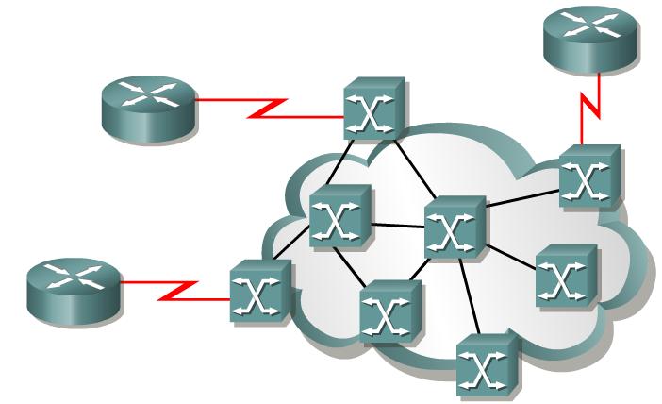
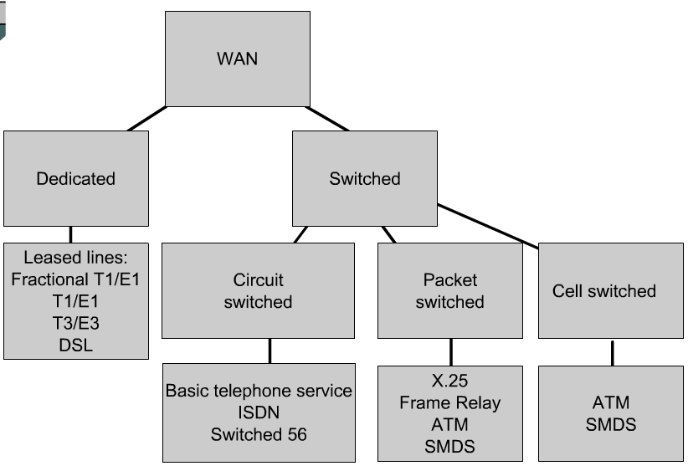
Frame Relay vs. X.25
Frame Relay does not have the sequencing, windowing, and retransmission mechanisms that are used by X.25.
Without the overhead, the streamlined operation of Frame Relay outperforms X.25.
Typical speeds range from 56 kbps up to 2 Mbps, although higher speeds are possible. (Up to 45 Mbps)
The network providing the Frame Relay service can be either a carrier-provided public network or a privately owned network.
Because it was designed to operate on high-quality digital lines, Frame Relay provides no error recovery mechanism.
If there is an error in a frame it is discarded without notification.

Slide 4
Introducing Frame Relay
A Frame Relay network may be privately owned, but it is more commonly provided as a service by a public carrier.
It typically consists of many geographically scattered Frame Relay switches interconnected by trunk lines.
Access circuits
Frame Relay is often used to interconnect LANs. When this is the case, a router on each LAN will be the DTE.
A serial connection, such as a T1/E1 leased line, will connect the router to a Frame Relay switch of the carrier at the nearest point-of-presence for the carrier. (access circuit)

Slide 5
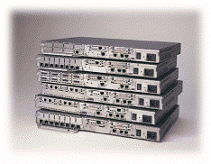
DTE – Data Terminal Equipment
DTEs generally are considered to be terminating equipment for a specific network and typically are located on the premises of the customer.
The customer may also own this equipment.
Examples of DTE devices are routers and Frame Relay Access Devices (FRADs).
A FRAD is a specialized device designed to provide a connection between a LAN and a Frame Relay WAN.

Slide 6
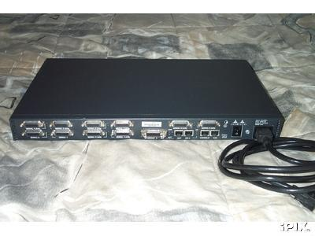
DCE – Data Communications Equipment
UNI
NNI
DCEs are carrier-owned internetworking devices.
The purpose of DCE equipment is to provide clocking and switching services in a network.
In most cases, these are packet switches, which are the devices that actually transmit data through the WAN.
The connection between the customer and the service provider is known as the User-to-Network Interface (UNI).
The Network-to-Network Interface (NNI) is used to describe how Frame Relay networks from different providers connect to each other.

Slide 7
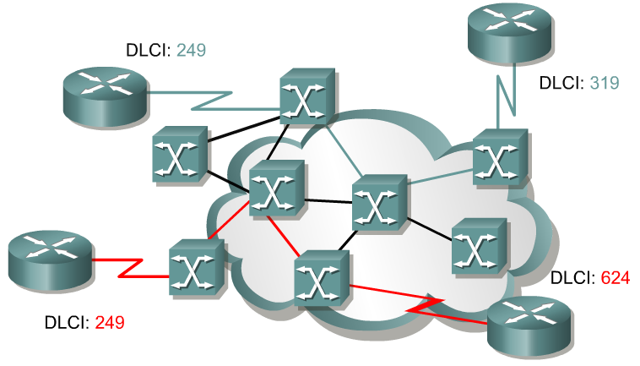
Frame Relay terminology
An SVC between the same two DTEs may change.
A PVC between the same two DTEs will always be the same.
Path may change.
Always same Path.
The connection through the Frame Relay network between two DTEs is called a virtual circuit (VC).
Switched Virtual Circuits (SVCs) are Virtual circuits may be established dynamically by sending signaling messages to the network.
However, SVCs are not very common.
Permanent Virtual Circuits (PVCs) are more common.
PVC are VCs that have been preconfigured by the carrier are used.
The switching information for a VC is stored in the memory of the switch.

Slide 8
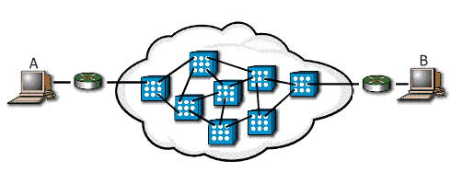
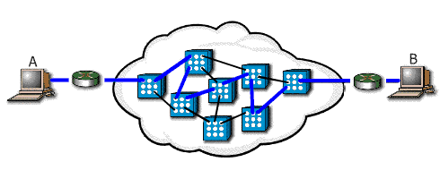

Slide Show Images(SVC) | Text
 | Call Setup: In this initial state, the virtual circuit between two Frame Relay DTE devices is established.
 | Data Transfer: Next, data is transmitted between the DTE devices over the virtual circuit.
Idling: In the idling stage, the connection is still open, but the data transfer has ceased.

Slide 9

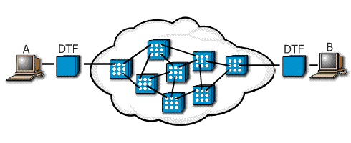
 | Call Termination: After the connection has idled for a particular period of time, the connection between the two DTEs is terminated
Permanent Virtual Circuits
PVCs are fixed paths and, therefore, are not created on demand or on a "call-by-call" basis. Although the actual path taken through the network may vary from time to time, such as when automatic rerouting takes place, the beginning and end of the circuit will not change. In this way, the PVC is like a dedicated point-to-point circuit.

Slide 10
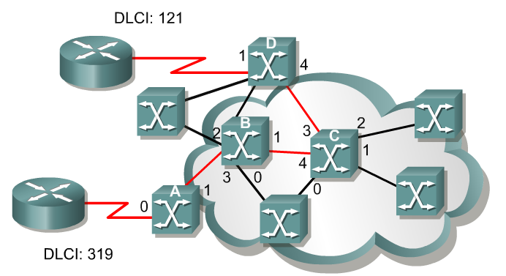
DLCI
A data-link connection identifier (DLCI) identifies the logical VC between the CPE and the Frame Relay switch.
The Frame Relay switch maps the DLCIs between each pair of routers to create a PVC.
DLCIs have local significance, although there some implementations that use global DLCIs.
DLCIs 0 to 15 and 1008 to 1023 are reserved for special purposes.
Service providers assign DLCIs in the range of 16 to 1007.
  DLCI 1019, 1020: Multicasts
  DLCI 1023: Cisco LMI
  DLCI 0: ANSI LMI

Slide 11
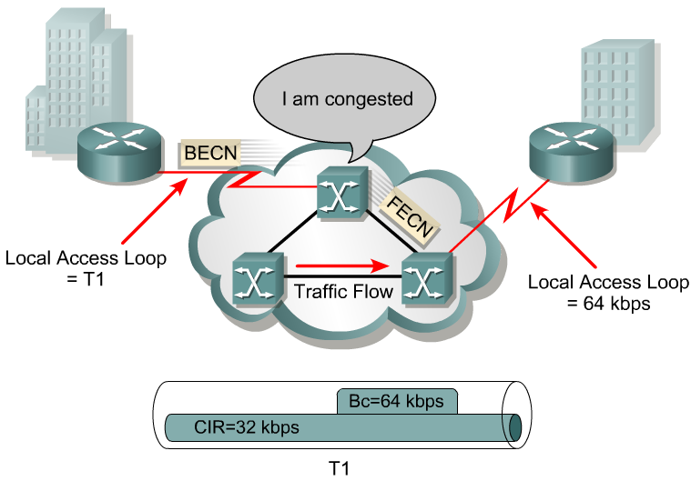
Frame Relay bandwidth and flow control
The first thing we need to do is become familiar with some of the terminology.
Local access rate – This is the clock speed or port speed of the connection or local loop to the Frame Relay cloud.
  It is the rate at which data travels into or out of the network, regardless of other settings.
Committed Information Rate (CIR) – This is the rate, in bits per second, at which the Frame Relay switch agrees to transfer data.
  The rate is usually averaged over a period of time, referred to as the committed rate measurement interval (Tc).

Slide 12
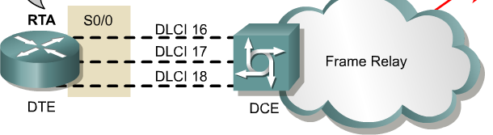
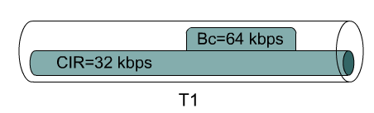
Frame Relay bandwidth and flow control
per VC
Oversubscription – Oversubscription is when the sum of the CIRs on all the VCs exceeds the access line speed.
  Oversubscription can also occur when the access line can support the sum of CIRs purchased, but not of the CIRs plus the bursting capacities of the VCs.
  Oversubscription increases the likelihood that packets will be dropped.

Slide 13
Frame Relay bandwidth and flow control
Tc = 2 seconds Bc = 64 kbps CIR = 32 kbps
Committed burst (Bc) – The maximum number of bits that the switch agrees to transfer during any Tc.
  The higher the Bc-to-CIR ratio, the longer the switch can handle a sustained burst.
  For example, if the Tc is 2 seconds and the CIR is 32 kbps, the Bc is 64 kbps.
  The Tc calculation is Tc = Bc/CIR.
Committed Time Interval (Tc) – Tc is not a recurrent time interval. It is used strictly to measure inbound data, during which time it acts like a sliding window. Inbound data triggers the Tc interval.

Slide 14
Frame Relay bandwidth and flow control
Excess burst (Be) – This is the maximum number of uncommitted bits that the Frame Relay switch attempts to transfer beyond the CIR.
  Excessive Burst (Be) is dependent on the service offerings available from your vendor, but it is typically limited to the port speed of the local access loop.
Excess Information Rate (EIR) – This defines the maximum bandwidth available to the customer, which is the CIR plus the Be.
  Typically, the EIR is set to the local access rate.
  In the event the provider sets the EIR to be lower than the local access rate, all frames beyond that maximum can be discarded automatically, even if there is no congestion.

Slide 15
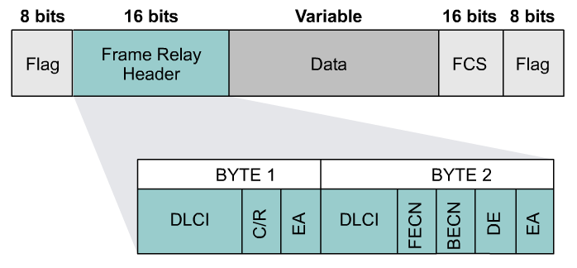
Frame Relay bandwidth and flow control
Forward Explicit Congestion Notification (FECN) – When a Frame Relay switch recognizes congestion in the network, it sends an FECN packet to the destination device.
  This indicates that congestion has occurred.
Backward Explicit Congestion Notification (BECN) – When a Frame Relay switch recognizes congestion in the network, it sends a BECN packet to the source router.
  This instructs the router to reduce the rate at which it is sending packets.
  With Cisco IOS Release 11.2 or later, Cisco routers can respond to BECN notifications.
  This topic is discussed later in this module.

Slide 16
Discard eligibility (DE) bit – When the router or switch detects network congestion, it can mark the packet "Discard Eligible".
  The DE bit is set on the traffic that was received after the CIR was met.
  These packets are normally delivered. However, in periods of congestion, the Frame Relay switch will drop packets with the DE bit set first.

Slide 17
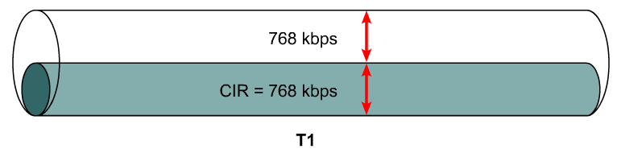
Frame Relay bandwidth
Several factors determine the rate at which a customer can send data on a Frame Relay network.
Foremost in limiting the maximum transmission rate is the capacity of the local loop to the provider.
If the local loop is a T1, no more than 1.544 Mbps can be sent.
In Frame Relay terminology, the speed of the local loop is called the local access rate.
Providers use the CIR parameter to provision network resources and regulate usage.
For example, a company with a T1 connection to the packet-switched network (PSN) may agree to a CIR of 768 Kbps.
This means that the provider guarantees 768 Kbps of bandwidth to the customer’s link at all times.

Slide 18
Frame Relay bandwidth
Typically, the higher the CIR, the higher the cost of service.
Customers can choose the CIR that is most appropriate to their bandwidth needs, as long as the CIR is less than or equal to the local access rate.
If the CIR of the customer is less than the local access rate, the customer and provider agree on whether bursting above the CIR is allowed.
If the local access rate is T1 or 1.544 Mbps, and the CIR is 768 Kbps, half of the potential bandwidth (as determined by the local access rate) remains available.

Slide 19
Frame Relay bandwidth
Many providers allow their customers to purchase a CIR of 0 (zero).
This means that the provider does not guarantee any throughput.
In practice, customers usually find that their provider allows them to burst over the 0 (zero) CIR virtually all of the time.
If a CIR of 0 (zero) is purchased, carefully monitor performance in order to determine whether or not it is acceptable.
Frame Relay allows a customer and provider to agree that under certain circumstances, the customer can “burst” over the CIR.
Since burst traffic is in excess of the CIR, the provider does not guarantee that it will deliver the frames.

Slide 20
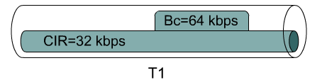
Frame Relay bandwidth
Either a router or a Frame Relay switch tags each frame that is transmitted beyond the CIR as eligible to be discarded.
When a frame is tagged DE, a single bit in the Frame Relay frame is set to 1.
This bit is known as the discard eligible (DE) bit.
The Frame Relay specification also includes a protocol for congestion notification.
This mechanism relies on the FECN/ BECN bits in the Q.922 header of the frame.
The provider’s switches or the customer’s routers can selectively set the DE bit in frames.
These frames will be the first to be dropped when congestion occurs.

Slide 21
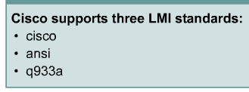
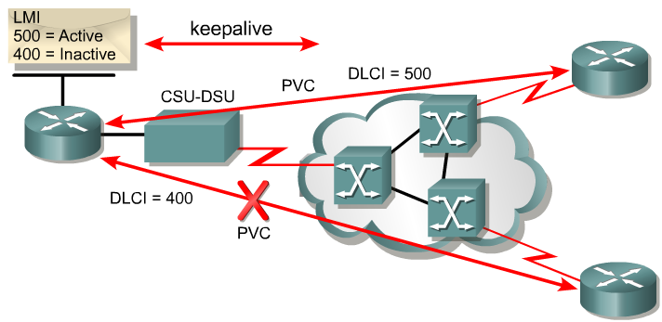
LMI – Local Management Interface
LMI is a signaling standard between
the DTE and the Frame Relay switch.
LMI is responsible for managing the connection and maintaining
the status between devices.
LMI includes:
  A keepalive mechanism, which verifies that data is flowing
  A multicast mechanism, which provides the network server (router) with its local DLCI.
  The multicast addressing, which can give DLCIs global rather than local significance in Frame Relay networks (not common).
  A status mechanism, which provides an ongoing status on the DLCIs known to the switch

Slide 22
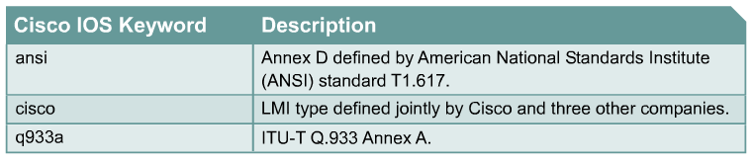
LMI
LMI
In order to deliver the first LMI services to customers as soon as possible, vendors and standards committees worked separately to develop and deploy LMI in early Frame Relay implementations.
The result is that there are three types of LMI, none of which is compatible with the others.
Cisco, StrataCom, Northern Telecom, and Digital Equipment Corporation (Gang of Four) released one type of LMI, while the ANSI and the ITU-T each released their own versions.
The LMI type must match between the provider Frame Relay switch and the customer DTE device.

Slide 23
LMI
LMI
In Cisco IOS releases prior to 11.2, the Frame Relay interface must be manually configured to use the correct LMI type, which is furnished by the service provider.
If using Cisco IOS Release 11.2 or later, the router attempts to automatically detect the type of LMI used by the provider switch.
This automatic detection process is called LMI autosensing.
No matter which LMI type is used, when LMI autosense is active, it sends out a full status request to the provider switch.

Slide 24
LMI
Frame Relay devices can now listen in on both DLCI 1023 or Cisco LMI and DLCI 0 or ANSI and ITU-T simultaneously.
The order is ansi, q933a, cisco and is done in rapid succession to accommodate intelligent switches that can handle multiple formats simultaneously.
The Frame Relay switch uses LMI to report the status of configured PVCs.
The three possible PVC states are as follows:
  Active state – Indicates that the connection is active and that routers can exchange data.
  Inactive state – Indicates that the local connection to the Frame Relay switch is working, but the remote router connection to the Frame Relay switch is not working.
  Deleted state – Indicates that no LMI is being received from the Frame Relay switch, or that there is no service between the CPE router and Frame Relay switch.

Slide 25
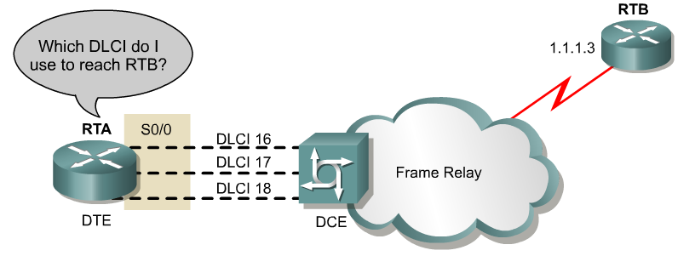
DLCI Mapping to Network Address
Manual
  Manual: Administrators use a frame relay map statement.
Dynamic
  Inverse Address Resolution Protocol (I-ARP) provides a given DLCI and requests next-hop protocol addresses for a specific connection.
  The router then updates its mapping table and uses the information in the table to forward packets on the correct route.

Slide 26
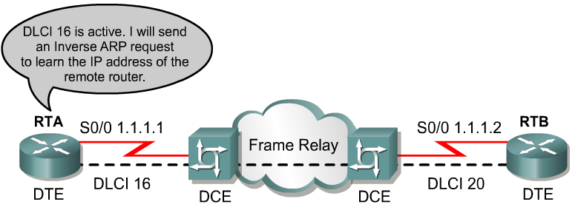

Inverse ARP
2
1
Once the router learns from the switch about available PVCs and their corresponding DLCIs, the router can send an Inverse ARP request to the other end of the PVC. (unless statically mapped – later)
For each supported and configured protocol on the interface, the router sends an Inverse ARP request for each DLCI. (unless statically mapped)
In effect, the Inverse ARP request asks the remote station for its Layer 3 address.
At the same time, it provides the remote system with the Layer 3 address of the local system.
The return information from the Inverse ARP is then used to build the Frame Relay map.

Slide 27

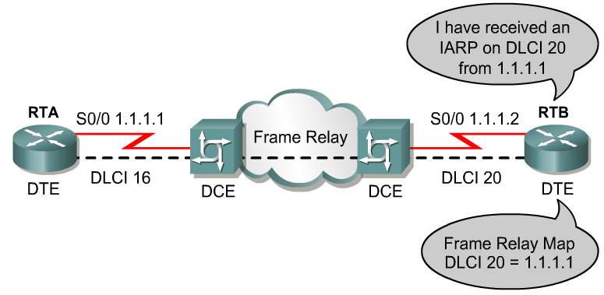

Inverse ARP
Inverse Address Resolution Protocol (Inverse ARP) was developed to provide a mechanism for dynamic DLCI to Layer 3 address maps.
Inverse ARP works much the same way Address Resolution Protocol (ARP) works on a LAN.
However, with ARP, the device knows the Layer 3 IP address and needs to know the remote data link MAC address.
With Inverse ARP, the router knows the Layer 2 address which is the DLCI, but needs to know the remote Layer 3 IP address.

Slide 28
Frame Relay Encapsulation
Router(config-if)#encapsulation frame-relay {cisco | ietf}
cisco - Default.
  Use this if connecting to another Cisco router.
Ietf - Select this if connecting to a non-Cisco router.
  RFC 1490

Slide 29
Frame Relay LMI
Router(config-if)#frame-relay lmi-type {ansi | cisco | q933a}
It is important to remember that the Frame Relay service provider maps the virtual circuit within the Frame Relay network connecting the two remote customer premises equipment (CPE) devices that are typically routers.
Once the CPE device, or router, and the Frame Relay switch are exchanging LMI information, the Frame Relay network has everything it needs to create the virtual circuit with the other remote router.
The Frame Relay network is not like the Internet where any two devices connected to the Internet can communicate.
In a Frame Relay network, before two routers can exchange information, a virtual circuit between them must be set up ahead of time by the Frame Relay service provider.

Slide 30
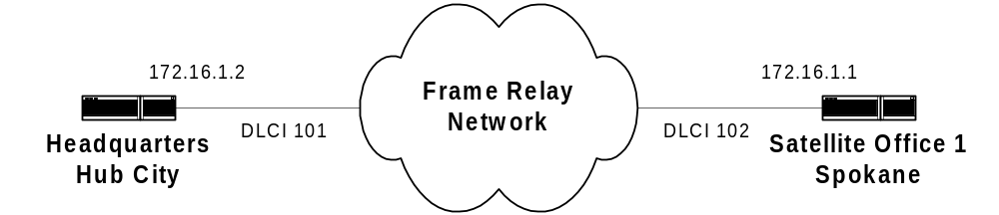
Minimum Frame Relay Configuration
HubCity(config)# interface serial 0
HubCity(config-if)# ip address 172.16.1.2 255.255.255.0
HubCity(config-if)# encapsulation frame-relay
Spokane(config)# interface serial 0
Spokane(config-if)# ip address 172.16.1.1 255.255.255.0
Spokane(config-if)# encapsulation frame-relay

Slide 31
Configuring Frame Relay maps
Router(config-if)#frame-relay map protocol protocol-address dlci [broadcast] [ietf | cisco]
If the environment does not support LMI autosensing and Inverse ARP, a Frame Relay map must be manually configured.
Use the frame-relay map command to configure static address mapping.
Once a static map for a given DLCI is configured, Inverse ARP is disabled on that DLCI.
The broadcast keyword is commonly used with the frame-relay map command.
The broadcast keyword provides two functions.
  Forwards broadcasts when multicasting is not enabled.
  Simplifies the configuration of OSPF for nonbroadcast networks that use Frame Relay. (coming)

Slide 32
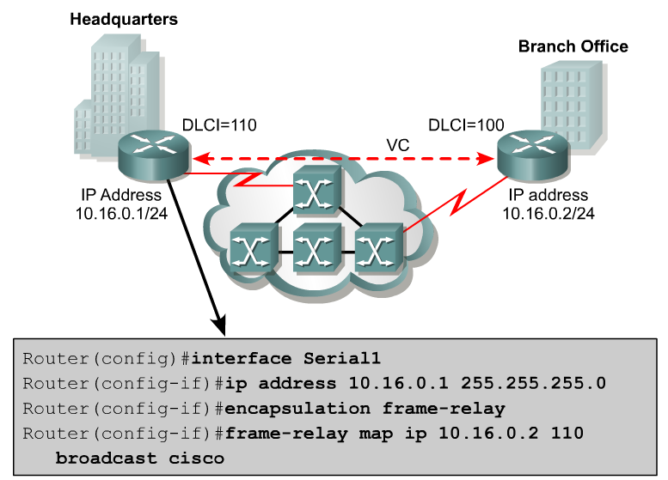
Frame Relay Maps
By default, cisco is the default encapsulation
Remote IP Address
Local DLCI
Uses cisco encapsulation for this DLCI (not needed, default)

Slide 33
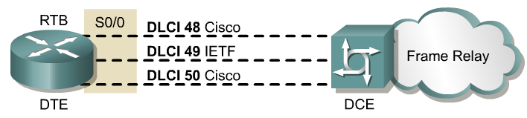
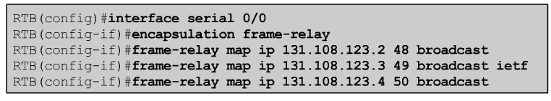
More on Frame Relay Encapsulation
Applies to all DLCIs unless configured otherwise
If the Cisco encapsulation is configured on a serial interface, then by default, that encapsulation applies to all VCs on that serial interface.
If the equipment at the destination is Cisco and non-Cisco, configure the Cisco encapsulation on the interface and selectively configure IETF encapsulation per DLCI, or vice versa.
These commands configure the Cisco Frame Relay encapsulation for all PVCs on the serial interface.
Except for the PVC corresponding to DLCI 49, which is explicitly configured to use the IETF encapsulation.

Slide 34
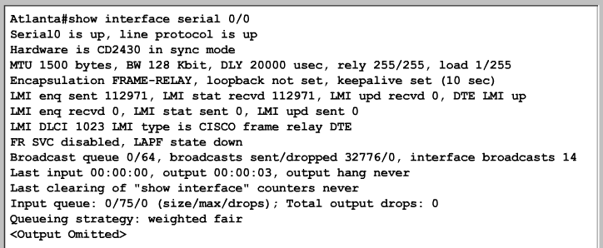
Verifying Frame Relay interface configuration
The show interfaces serial command displays information regarding the encapsulation and the status of Layer 1 and Layer 2.
It also displays information about the multicast DLCI, the DLCIs used on the Frame Relay-configured serial interface, and the DLCI used for the LMI signaling.

Slide 35
show interfaces serial
Atlanta(config)#interface serial 0/0
Atlanta(config-if)#description Circuit-05QHDQ101545-080TCOM-002
Atlanta(config-if)#^z
Atlanta#show interfaces serial 0/0
Serial 0/0 is up, line protocol is up Hardware is MCI Serial
Description Circuit-05QHDQ101545-080TCOM-002
Internet address is 150.136.190.203, subnet mask 255.255.255.0
MTU 1500 bytes, BW 1544 Kbit, DLY 20000 uses, rely 255/255, load 1/255
To simplify the WAN management, use the description command at the interface level to record the circuit number.

Slide 36
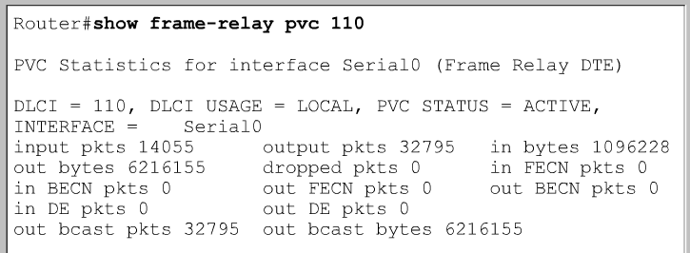
show frame-relay pvc
The show frame-relay pvc command displays the status of each configured connection, as well as traffic statistics.
This command is also useful for viewing the number of Backward Explicit Congestion Notification (BECN) and Forward Explicit Congestion Notification (FECN) packets received by the router.
The command show frame-relay pvc shows the status of all PVCs configured on the router.
If a single PVC is specified, only the status of that PVC is shown.

Slide 37
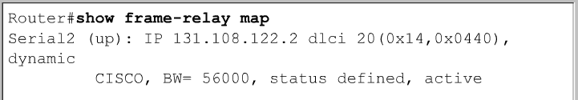
show frame-relay map
The show frame-relay map command displays the current map entries and information about the connections.

Slide 38
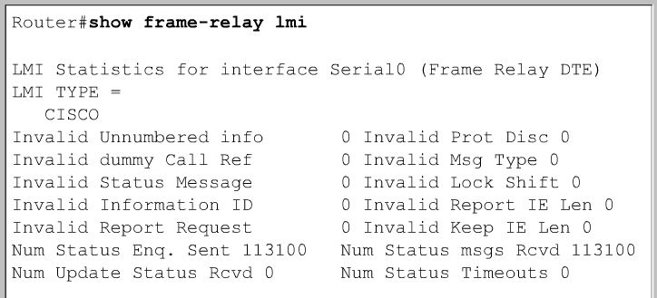
show frame-relay lmi
The show frame-relay lmi command displays LMI traffic statistics showing the number of status messages exchanged between the local router and the Frame Relay switch.

Slide 39
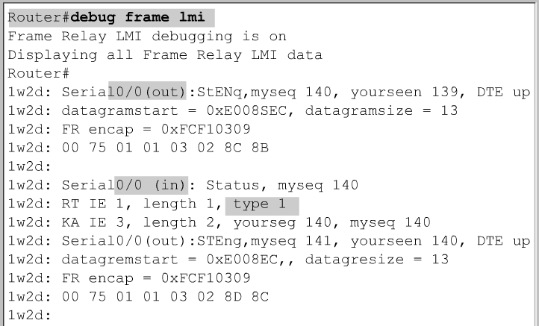
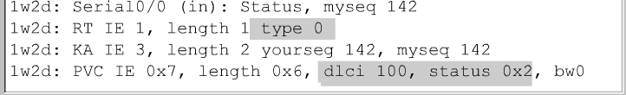
Troubleshooting the Frame Relay configuration
Use the debug frame-relay lmi command to determine whether the router and the Frame Relay switch are sending and receiving LMI packets properly.

Slide 40
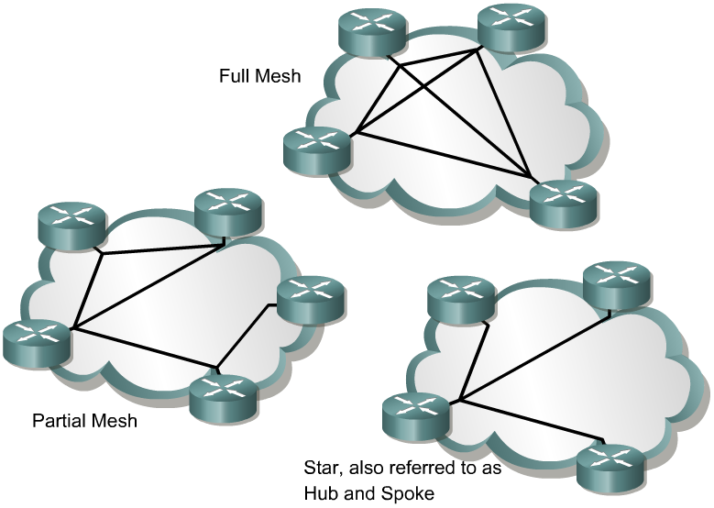
Frame Relay Topologies

Slide 41
Frame Relay Map Statements
Router(config-if)#frame-relay map protocol protocol-address dlci [broadcast] [ietf | cisco]
Instead of using additional PVCs, Frame-Relay map statements can be used to:
Statically map local DLCIs to an unknown remote network layer addresses.
Also used when the remote router does not support Inverse ARP

Slide 42
Configuring Frame Relay subinterfaces
RTA(config)#interface s0/0
RTA(config-if)#encapsulation frame-relay ietf
Router(config-if)#interface serial number subinterface-number {multipoint | point-to-point}
Router(config-subif)# frame-relay interface-dlci dlci-number
Subinterface can be configured after the physical interface has been configured for Frame Relay encapsulation
Subinterface numbers can be specified in interface configuration mode or global configuration mode.
subinterface number can be between 1 and 4294967295.
At this point in the subinterface configuration, either configure a static Frame Relay map or use the frame-relay interface-dlci command.
The frame-relay interface-dlci command associates the selected subinterface with a DLCI.

Slide 43
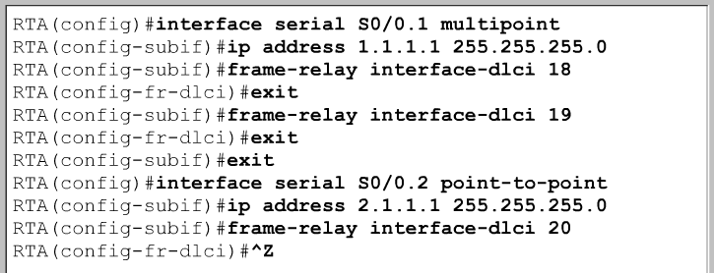
Configuring Frame Relay subinterfaces
The frame-relay interface-dlci command is required for all point-to-point subinterfaces.
It is also required for multipoint subinterfaces for which inverse ARP is enabled.
It is not required for multipoint subinterfaces that are configured with static route maps.
It can not be used on physical interfaces.

Slide 44
Show frame-relay map
Point-to-point subinterfaces are listed as a “point-to-point dlci”
Router#show frame-relay map
Serial0.1 (up): point-to-point dlci, dlci 301 (0xCB, 0x30B0), broadcast status defined, active
With multipoint subinterfaces, they are listed as an inverse ARP entry, “dynamic”
Router#show frame-relay map
Serial0 (up): ip 172.30.2.1 dlci, 301 (0x12D, 0x48D0), dynamic,, broadcast status defined, active

Slide 45
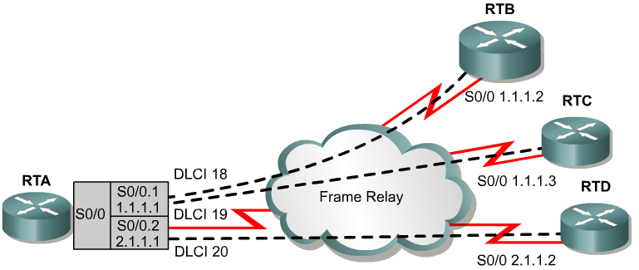
Point-to-point Subinterfaces
Mulitpoint
Point-to-point
Point-to-point subinterfaces are like conventional point-to-point interfaces (PPP, …) and have no concept of (do not need):
Inverse-ARP
mapping of local DLCI address to remote network address (frame-relay map statements)
Frame-Relay service supplies multiple PVCs over a single physical interface and point-to-point subinterfaces subdivide each PVC as if it were a physical point-to-point interface.
Point-to-point subinterfaces completely bypass the local DLCI to remote network address mapping issue.

Slide 46
Point-to-point Subinterfaces
Mulitpoint
Point-to-point
With point-to-point subinterfaces you:
Cannot have multiple DLCIs associated with a single point-to-point subinterface
Cannot use frame-relay map statements
Cannot use Inverse-ARP
Can use the frame-relay interface dlci statement (for both point-to-point and multipoint)

Slide 47
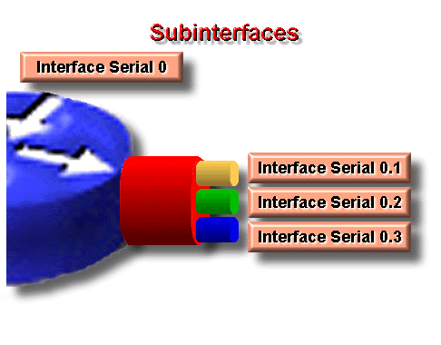
Point-to-point Subinterfaces
Each subinterface is on a separate network or subnet with a single remote router at the other end of the PVC.
172.30.1.0/24
172.30.2.0/24
172.30.3.0/24

Slide 48
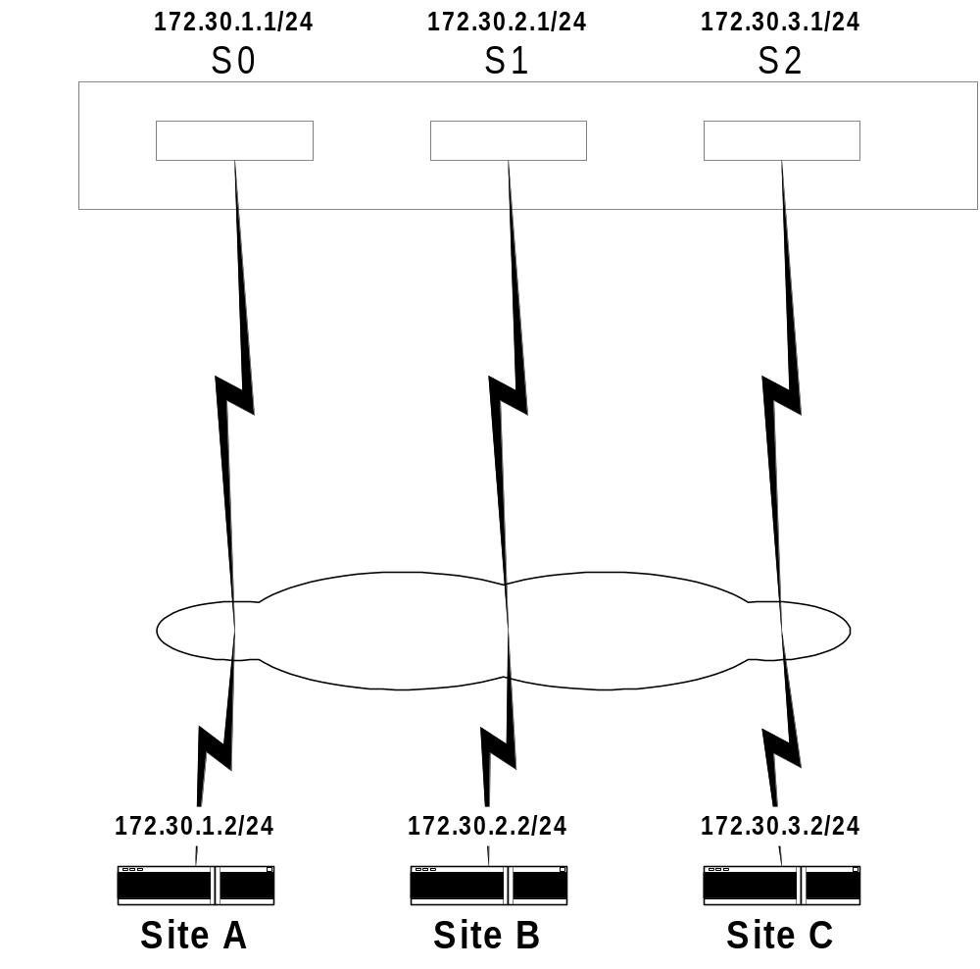
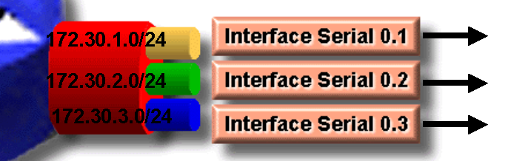
Point-to-point subinterfaces are equivalent to using multiple physical “point to point” interfaces.

Slide 49
Point-to-point Subinterfaces
A single subinterface is used to establish one PVC connection to another physical or subinterface on a remote router.
In this case, the interfaces would be:
  In the same subnet and
  Each interface would have a single DLCI
Each point-to-point connection is its own subnet.
In this environment, broadcasts are not a problem because the routers are point-to-point and act like a leased line.

Slide 50
Point-to-point Subinterfaces
Point-to-point subinterface configuration, minimum of two commands:
Router(config)# interface Serial0.1 point-to-point
Router(config-subif)# frame-relay interface-dlci dlci
Rules:
1. No Frame-Relay map statements can be used with point-to-point subinterfaces.
2. One and only one DLCI can be associated with a single point-to-point subinterface
By the way, encapsulation is done only at the physical interface:
interface Serial0
no ip address
encapsulation frame-relay

Slide 51
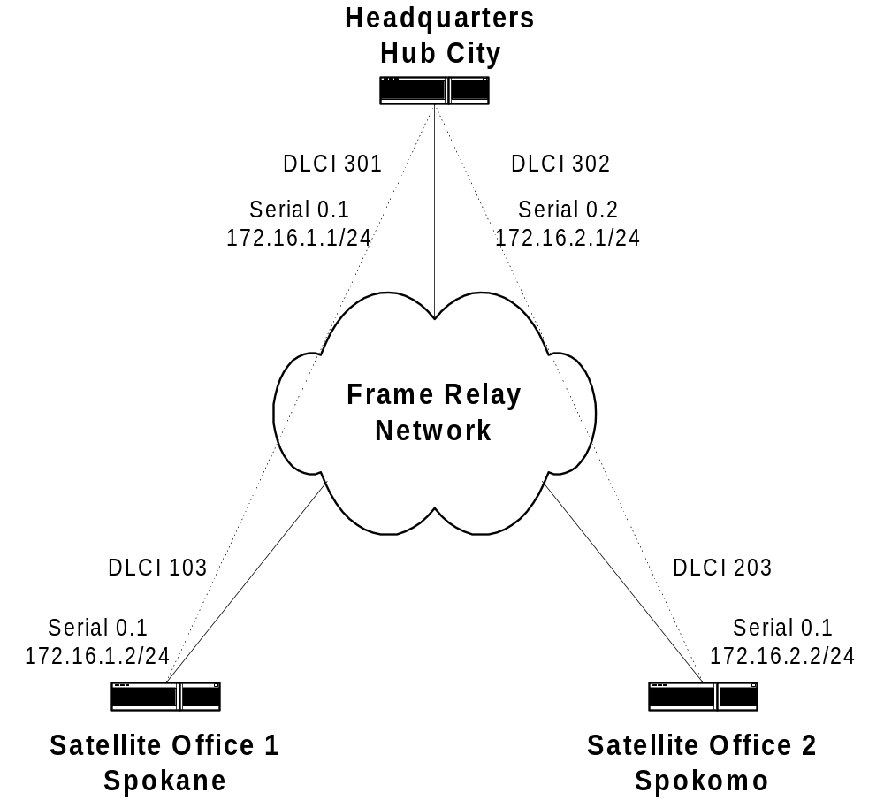
Each subinterface on Hub router requires a separate subnet (or network)
Each subinterface on Hub router is treated like a regular physical point-to-point interface, so split horizon does not need to be disabled.
Interface Serial0 (for all routers)
encapsulation frame-relay
no ip address
HubCity
interface Serial0.1 point-to-point
ip address 172.16.1.1 255.255.255.0
encapsulation frame-relay
frame-relay interface dlci 301
interface Serial0.2 point-to-point
ip address 172.16.2.1 255.255.255.0
encapsulation frame-relay
frame-relay interface dlci 302
Spokane
interface Serial0.1 point-to-point
ip address 172.16.1.2 255.255.255.0
frame-relay interface dlci 103
Spokomo
interface Serial0.1 point-to-point
ip address 172.16.2.2 255.255.255.0
frame-relay interface dlci 203
Point-to-Point Subinterfaces at the Hub and Spokes
Two subnets

Slide 52
Multipoint Subinterfaces
Mulitpoint
Point-to-point
Share many of the same characteristics as a physical Frame-Relay interface
With multipoint subinterface you can have:
can have multiple DLCIs assigned to it.
can use frame-relay map & interface dlci statements
can use Inverse-ARP
Remember, with point-to-point subinterfaces you:
cannot have multiple DLCIs associated with a single point-to-point subinterface
cannot use frame-relay map statements
cannot use Inverse-ARP

Slide 53
Multipoint subinterfaces
Each subinterface is on a separate network or subnet but may have multiple connections, with a different DLCI for each connection.
172.30.1.0/24
172.30.2.0/24
172.30.3.0/24
Split horizon still an issue on each Multipoint subinterface.

Slide 54
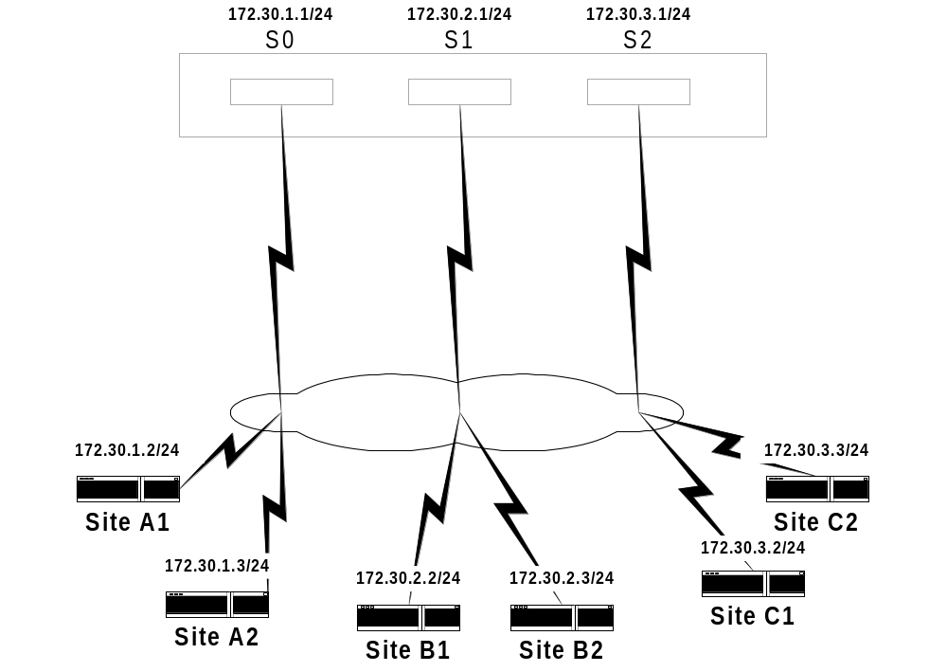
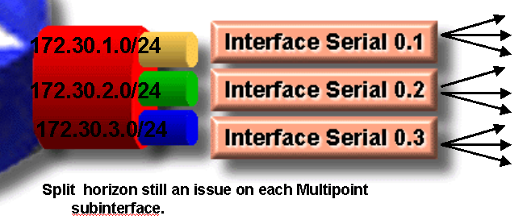
Multipoint subinterfaces are equivalent to using multiple physical “hub to spoke” interfaces.

Slide 55
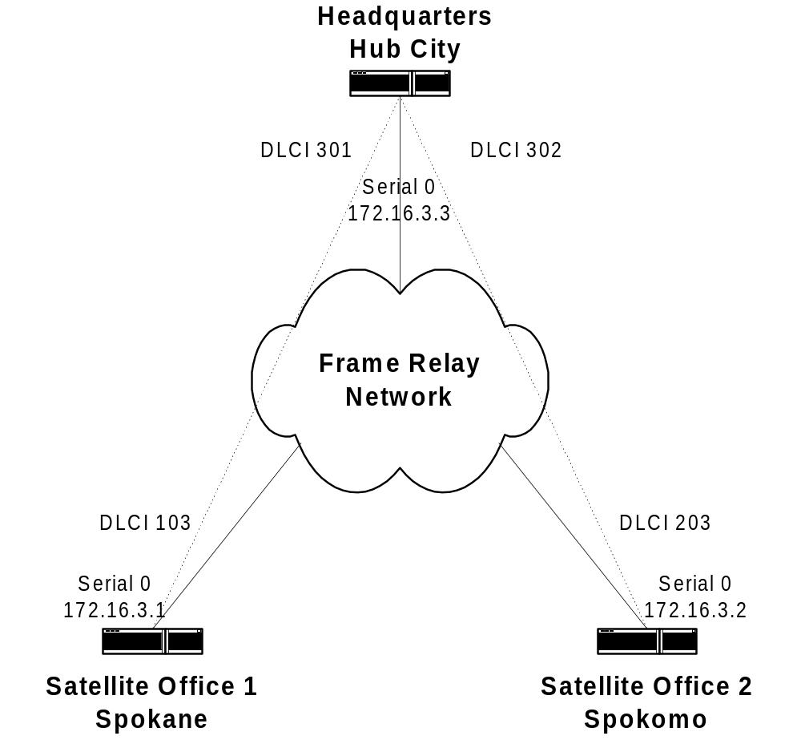
Multipoint subinterface at the Hub and Point-to-Point Subinterfaces at the Spokes
Notes
Highly scalable solution
Disable Split Horizon on Hub router when running a distance vector routing protocol
Interface Serial0 (for all routers)
encapsulation frame-relay
no ip address
HubCity
interface Serial0.1 mulitpoint
ip address 172.16.3.3 255.255.255.0
frame-relay interface-dlci 301
frame-relay interface-dlci 302
no ip split-horizon
Spokane
interface Serial0.1 point-to-point
ip address 172.16.3.1 255.255.255.0
frame-relay interface-dlci 103
Spokomo
interface Serial0.1 point-to-point
ip address 172.16.3.2 255.255.255.0
frame-relay interface-dlci 203
One subnet

